Slide 1


Slide 2
Convolutional Neural Network (CNN) is a well-known deep learning architecture inspired by the natural visual perception mechanism of the living creatures.
https://arxiv.org/pdf/1512.07108.pdf

Slide 3
The name “Convolutional Neural Network” comes from the use of the mathematical operation convolution in the network.
In Machine Learning, CNN, or ConvNet
is a class of deep, Feedforward ANNs, most commonly applied to analyzing visual imagery.
CNnsare trained with a version of the back-propagation algorithm(BPA).

Slide 4
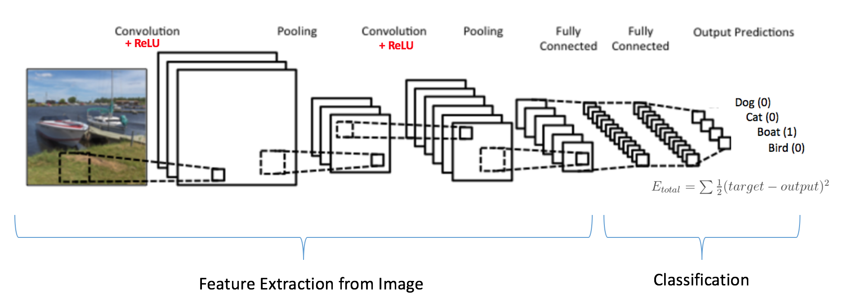

Slide 5
The initial layers find edges in an image, or identify color of image.
The later layers build upon this for complex structure such as finding intersection of edges or shades of colors.
The final layer then brings all of this together to identify the object in the image.

Slide 6
Apart from Image Classification, CNNs are now also used for many other applications like:
Object Localization and Object Detection
Image Segmentation
Image Captioning
Style Transfer
Video Analysis
Medical Diagnosis
Image Coloring
Super Resolution
Speech Recognition
Document Classification
Self Driving Cars
Drug discovery to prediction of disease
NLP
Games….

Slide 7
Comparison of CNN
with
MLP

Slide 8
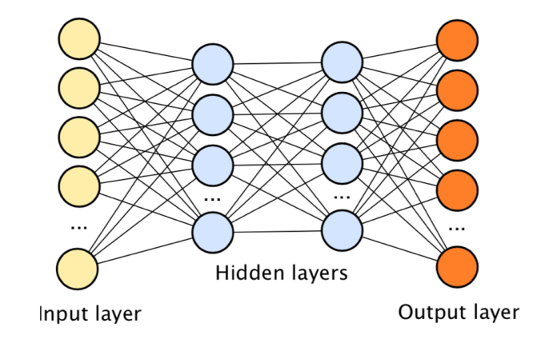
MLP- FULLY CONNECTED

Slide 9
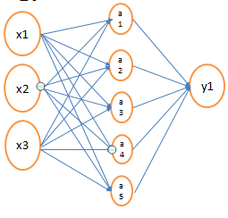
Number of Parameters (weights) assuming (i)biases present
(ii) Biases absent
As the dimensionality of the data increases the number of parameters in the model also increases.

Slide 10
(a)Consider a neural network which classifies the Cat and non cat images, having inputs as images of dimensions 224x224x3, 1 hidden layer having 512 hidden units and one output giving 1 for a cat image and 0 otherwise. Estimate the number of parameters in this model. Assume no biases are used in the model.
(b) What about the number of parameters when images are of dimensions 512x512x3.

Slide 11
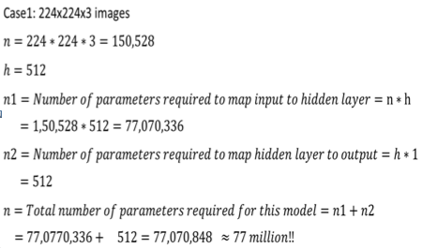

Slide 12
Problems with traditional Neural Network Models
Fully connected Networks or Multi Layer Perceptron Model mainly suffers from two big limitations:
Huge number of parameters (weights) are required when inputs are high dimensional.
Does not handle the spatial and temporal aspect of the data.

Slide 13
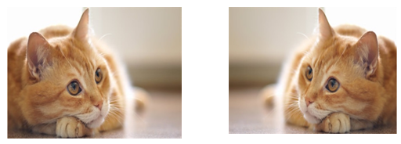
Spatial Aspect of data
Both are the same images, the second image is obtained by flipping the first image horizontally.
Although the subject of the images is same but the order of pixels have completely changed now

Slide 14
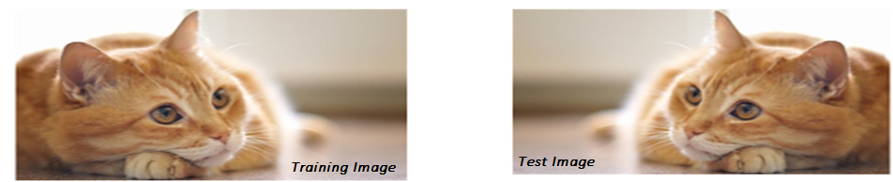
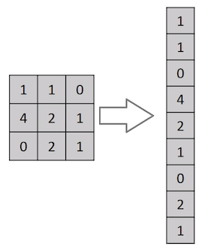
in fully connected neural networks the weights corresponding to each pixel in the image are learnt, the order in which the pixels are present in the image matters.

Slide 15
If we trained our neural network with images of cats with its face in the left hand side, then neurons of the network will fire when they see the cat face at the left.
If an inverted image is inputted, the pixels on the left won’t correspond to a cat face, instead will correspond to the background and hence we might get different results.

Slide 16
What other operations can change the order of the pixels ???
shifting the image by some amount,
cropping the image or
any other operations which change the order of the pixels would result in the same problem.
Need a neural network model which is not affected by the order in which the pixels are processed, but instead looks for the presence of certain pixels in the image.

Slide 17
CNNs differ from MLP in:
SHARED-WEIGHTS ARCHITECTURE CNNs require Fewer parameters (weights and biases)
IMAGE INVARIANCE Characteristics.
Even when an image is rotated, sized differently or viewed in different illumination an object will be recognized as the same object –Image Invariance, which
do not depend on where the feature occurs in the image.
Can tolerate some distortion in the images.
Also known as shift invariant or space invariant ANNs (SIANN)

Slide 18
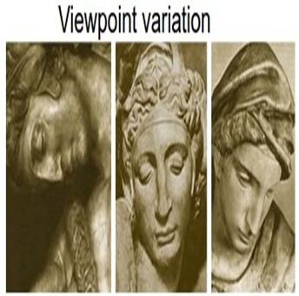
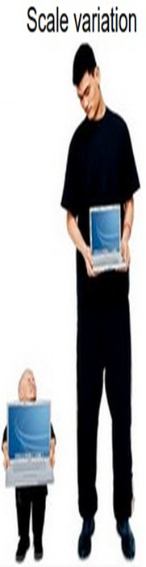
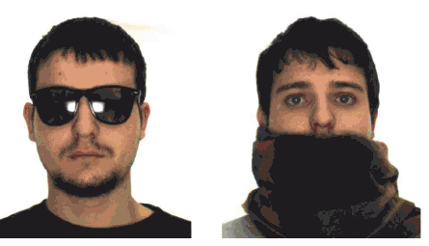
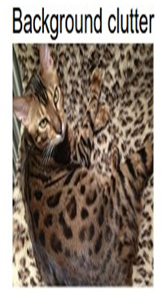
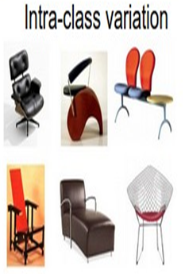
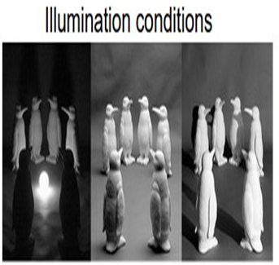
Occlusion

Slide 19
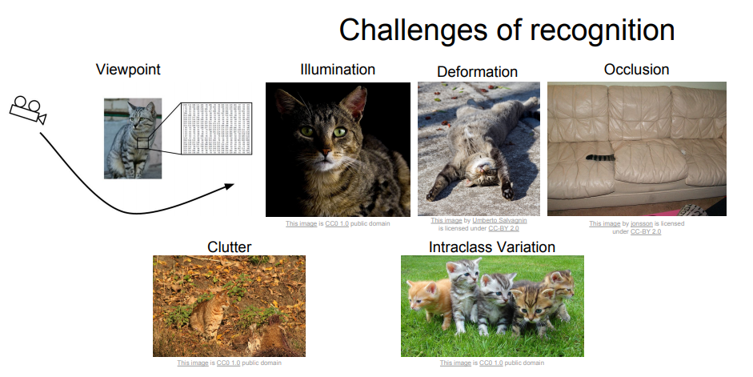

Slide 20
Historical Context and Motivation
CNNs were developed in late 1980s and then forgotten about due to the lack of processing power.
With advent of cheap, but powerful GPUs (graphics cards), research on CNNs and Deep Learning was given new life.

Slide 21
In 1995, Yann LeCun and Yoshua Bengio introduced the concept of CNNs.
Y. LeCun, L. Bottou, Y. Bengio, and P. Haffner.
Gradient-based learning applied to document recognition
.Proceedings of the IEEE, November 1998.
http://vision.stanford.edu/cs598_spring07/papers/Lecun98.pdf

Slide 22
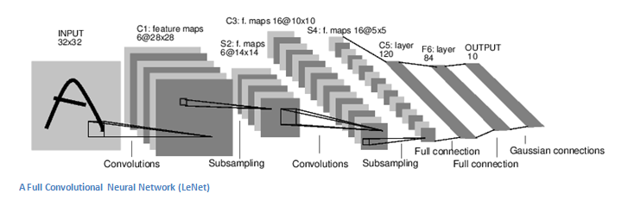
1998 paper introduced famous LeNet-5 architecture widely used by banks to recognize handwritten check numbers was one of the very first convolution neural networks which helped propel the field of Deep Learning.

Slide 23
Publication of the paper, “ImageNet Classification with Deep Convolutional Neural Networks” in 2012 by Alex Krizhevsky, Ilya Sutskever, and Geoffrey E. Hinton introducing AlexNet was a seismic shift that broke the Richter scale! As of 2018 it has been cited over 25,000 times.
The paper forged a new landscape in Computer Vision by demolishing old ideas in one masterful stroke.
The original paper's primary result was that the depth of the model was essential for its high performance, which was computationally expensive, but made feasible due to the utilization of GPUs during training

Slide 24
Some of the most important innovations have sprung from submissions by academics and industry leaders to the ImageNet Large Scale Visual Recognition Challenge, or ILSVRC--- called the Olympics for “seeing computers”
The ILSVRC is an annual computer vision competition developed upon a subset of a publicly available computer vision dataset called ImageNet.
As such, the tasks and even the challenge itself is often referred to as the ImageNet Competition.

Slide 25
The general challenge tasks for most years are as follows:
Image classification: Predict the classes of objects present in an image.
Single-object localization: Image classification + draw a bounding box around one example of each object present.
Object detection: Image classification + draw a bounding box around each object present.

Slide 26
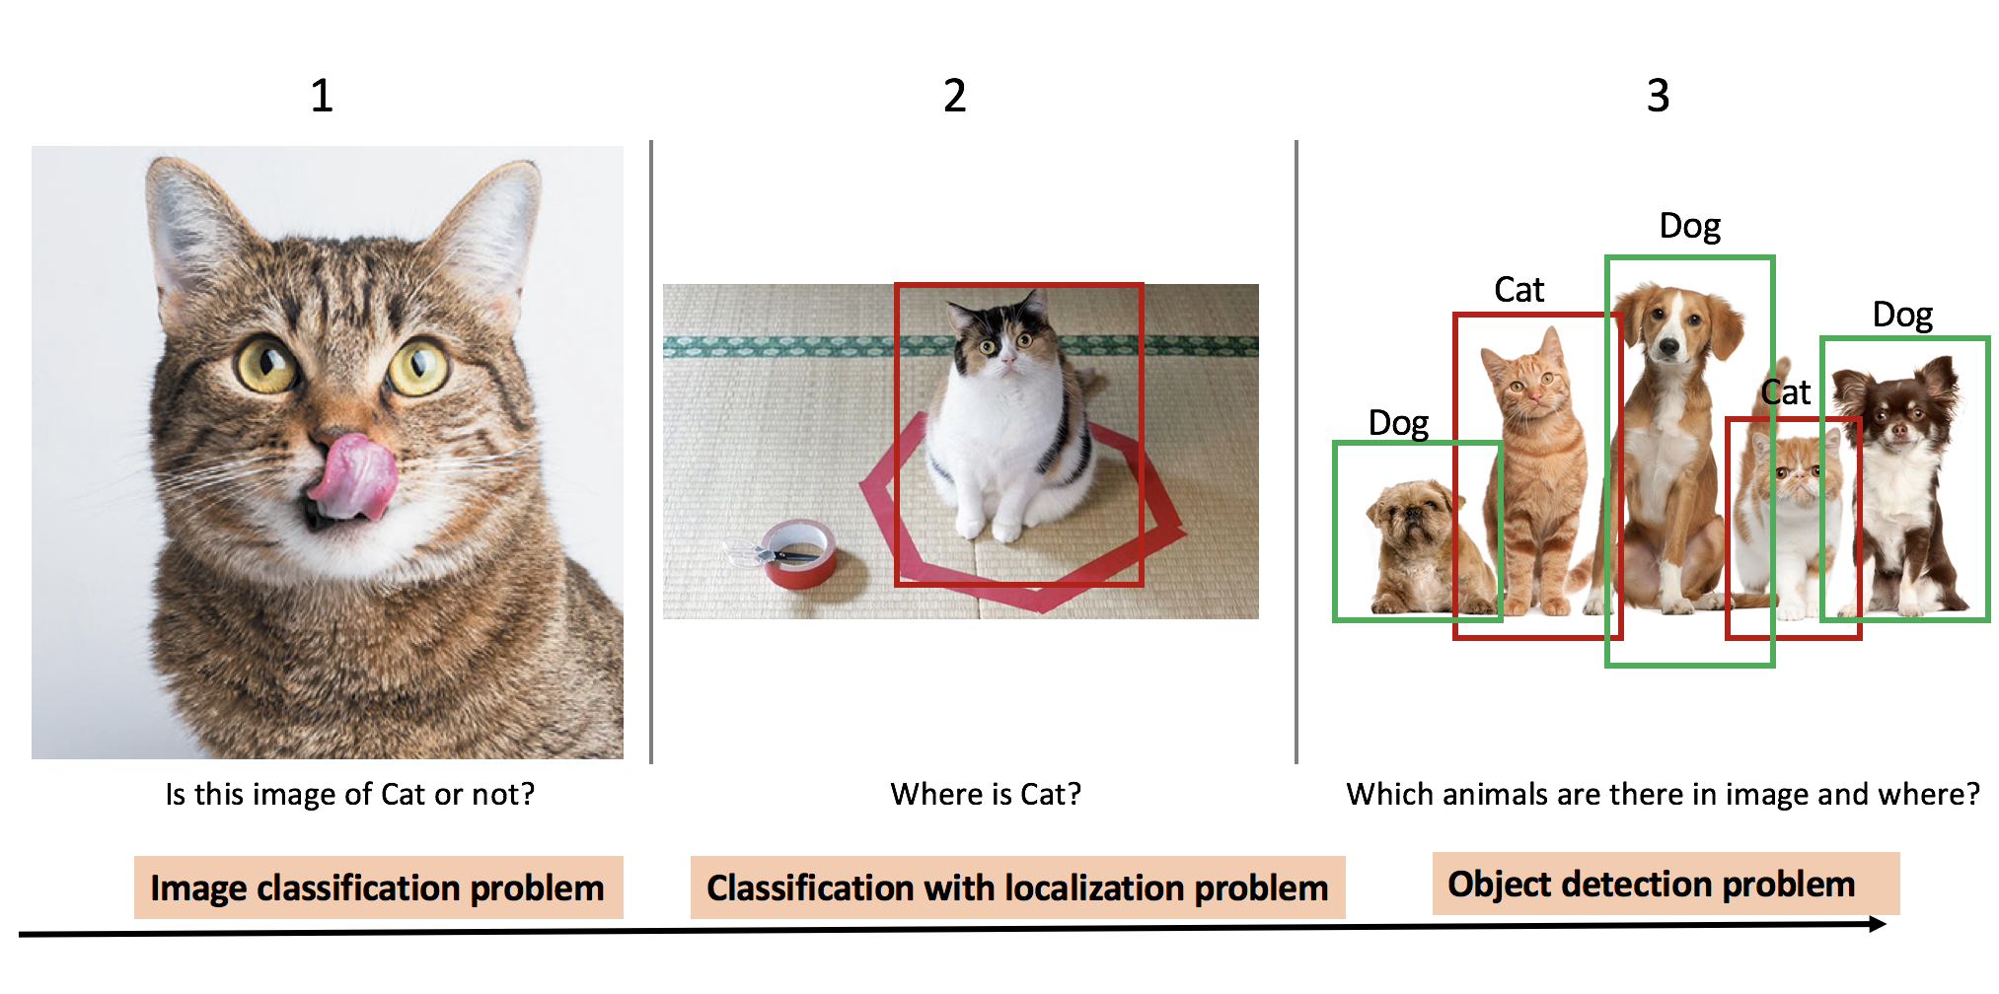

Slide 27
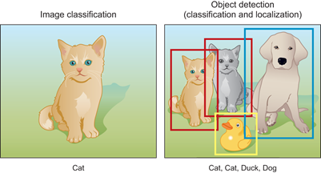

Slide 28
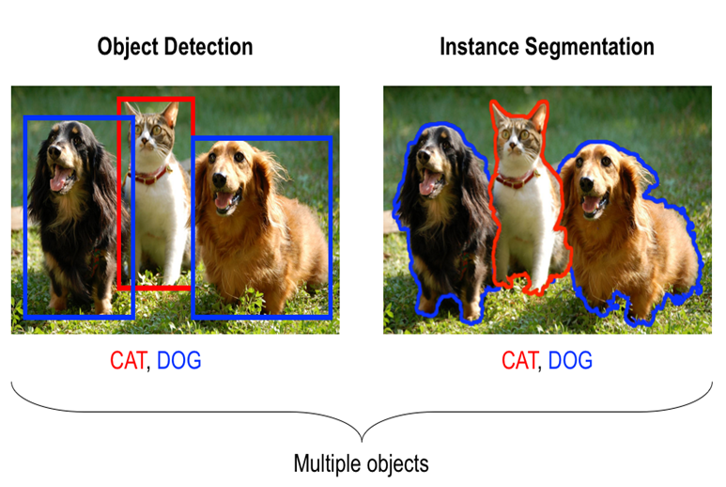

Slide 29
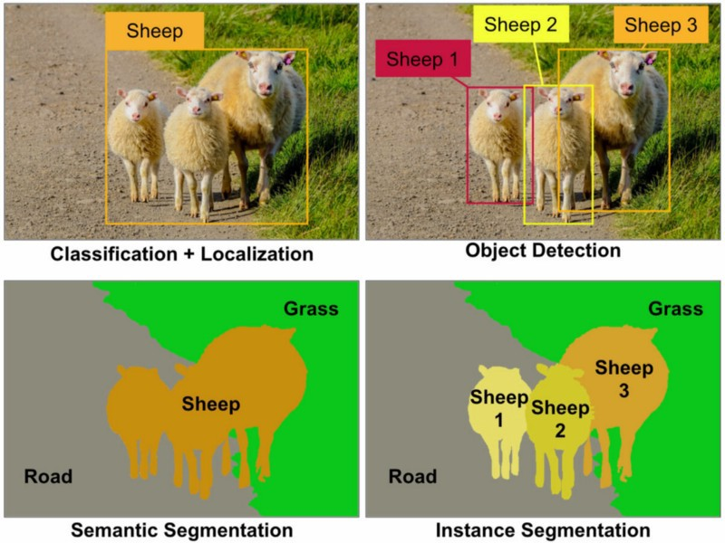

Slide 30
AlexNet has had a large impact on the field of machine learning, specifically in the application of deep learning to machine vision.
The paper used a CNN to get a Top-5 error rate (rate of not finding the true label of a given image among its top 5 predictions) of 15.3%. The next best result trailed far behind (26.2%).
Microsoft’s ResNets achieved a top 5 error of 3.6% which is better than the human level performance on the same task.

Slide 31
First, you make a prediction using the CNN and obtain the predicted class ∑pclass=1
Now, in the case of top-1 score, check if the top class (the one having the highest probability) is the same as the target label.
In the case of top-5 score, check if the target label is one of top 5 predictions (the 5 ones with the highest probabilities).
In both cases, the top score is computed as the times a predicted label matched the target label, divided by the number of data-points evaluated.

Slide 32
We have "cat", "dog", "house", "mouse" as classes (in this order).
classifier output :
0.1; 0.2; 0.0; 0.7
The Top-1 class is "mouse".
The top-2 classes are {mouse, dog}.
If the correct class was "dog", it would be counted as "correct" for the Top-2 accuracy, but
“wrong” for the Top-1 accuracy.

Slide 33
if a test image is a picture of a Persian cat, and the top 5 predicted classes in order are
Pomeranian(0.4),Mongoose(0.25),Dingo (0.15), Persian cat(0.1), Tabby cat(0.02)
then it is still treated as being 'correct' because the actual class is in the top 5 predicted classes for this test image.
Remember to keep in mind that ImageNet contains 14 million images in more than 20 000 categories , so a low top-5 error rate is still not extremely easy to achieve.

Slide 34
What are Convolutional Neural Networks and how they work???

Slide 35
CNNs are MLPs with a special structure.
CNN is a specialized kind of neural network for processing the data which has the grid like topology.
Examples of such data are :
Images which can be considered as a 2D (224x224 grayscale) or 3-channel (coloured RGB) grid of pixels,
Time series data which can be thought of as the 1D grid taking samples at regular time intervals

Slide 36
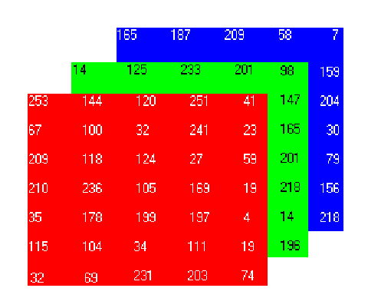

Slide 37
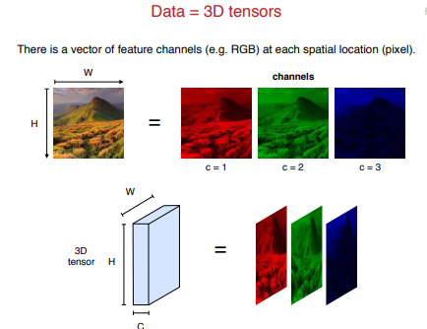

Slide 38

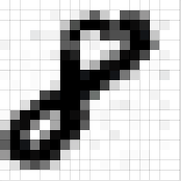
A grayscale image, on the other hand, has just one channel.

Slide 39
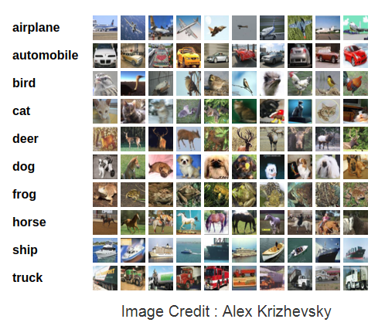
The CIFAR10 comes bundled with Keras.
It has 50,000 training images and 10,000 test images.

Slide 40
Popular Databases
CIFAR-10 (Canadian Institute For Advanced Research)dataset classification is a common benchmark problem in machine learning.
The problem is to classify RGB 32x32 pixel images across 10 categories:
airplane, automobile, bird, cat, deer, dog, frog, horse, ship, and truck.

Slide 41
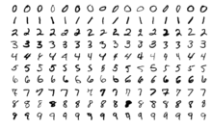
MNIST Database
The MNIST database is a large database of handwritten digits that is commonly used for training various image processing systems.
The MNIST database contains 60,000 training images and 10,000 testing images.

Slide 42
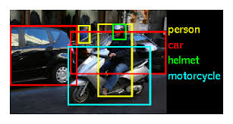
ImageNet
Over 14 million URLs of images have been hand-annotated by ImageNet to indicate what objects are pictured and in at least one million of the images, bounding boxes are also provided.
ImageNet contains over 20 thousand categories, such as "balloon" or "strawberry“,contains several hundred images.

Slide 43
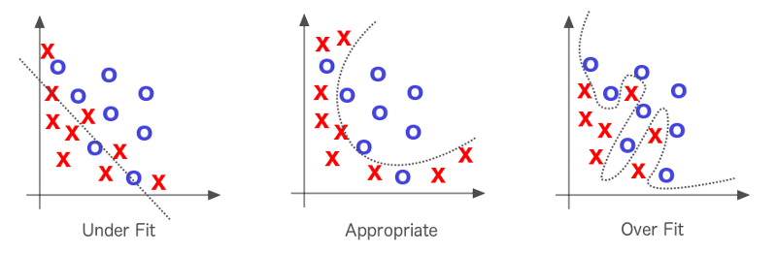
As model complexity increases , overfitting happens, generalization is poor

Slide 44
One of the major reasons for overfitting is that you don’t have enough data to train your network.
Apart from Regularization/Early stopping, another very effective way to counter Overfitting is Data Augmentation.
It is the process of artificially creating more images from the images you already have by changing the size, orientation etc of the image.
It can be a tedious task but fortunately, this can be done in Keras using the ImageDataGenerator instance.

Slide 45
Examples of transformations are:
Flipping the image horizontally / vertically
Rotating the image X degrees.
Trimming, expanding, resizing, …
Applying perspective deformations
Adjusting brightness, contrast, saturation, …
Adding some noise, defects, …
A combination of the above

Slide 46
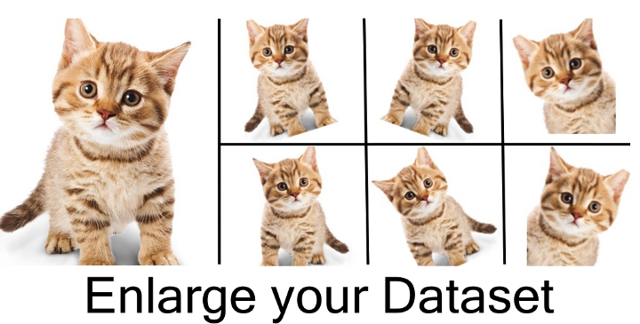

Slide 47
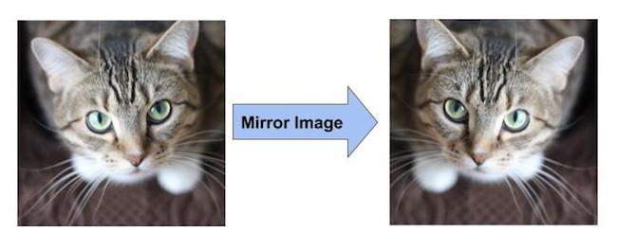
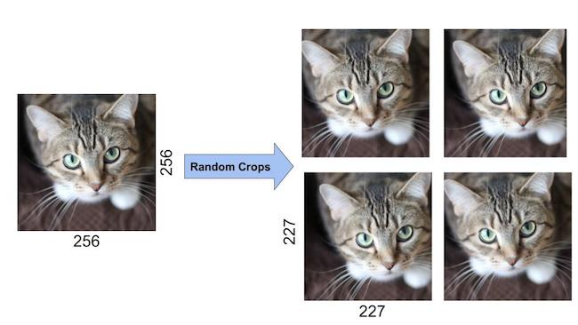

Slide 48
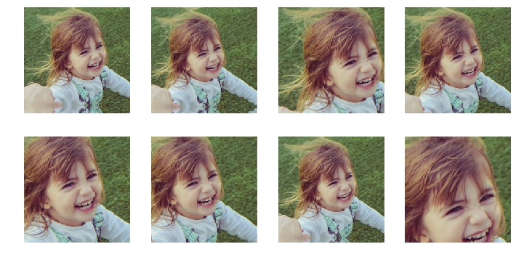
Random Crop, Zoom

Slide 49
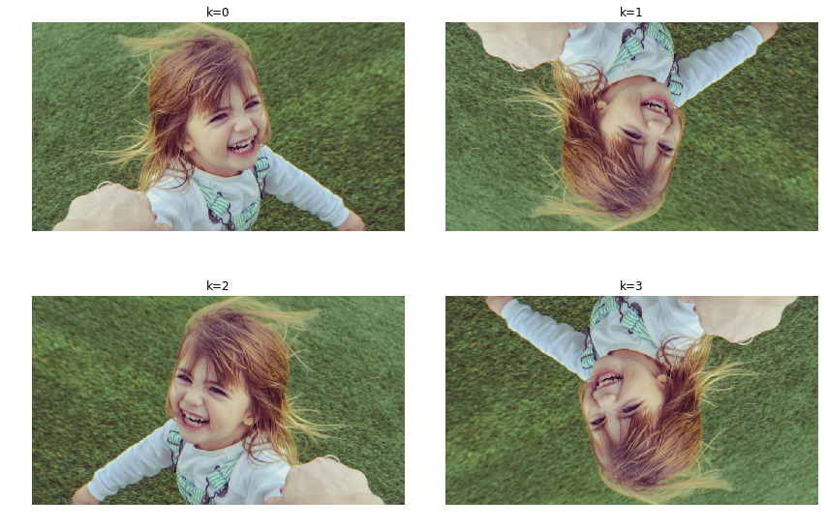
Dihedral
It will rotate the image in all such possible orientations.

Slide 50
CUTOUT REGULARISATION
A technique now commonly used on the very latest ImageNet models.
Cutout can be really seen as a form of augmenting the data to handle occlusion - an extremely common challenge in real-world applications, especially in the hot computer vision areas of robotics, surveillance, and self-driving cars.
By applying a form of occlusion to the training data, network is effectively adapted to be more robust to it.

Slide 51
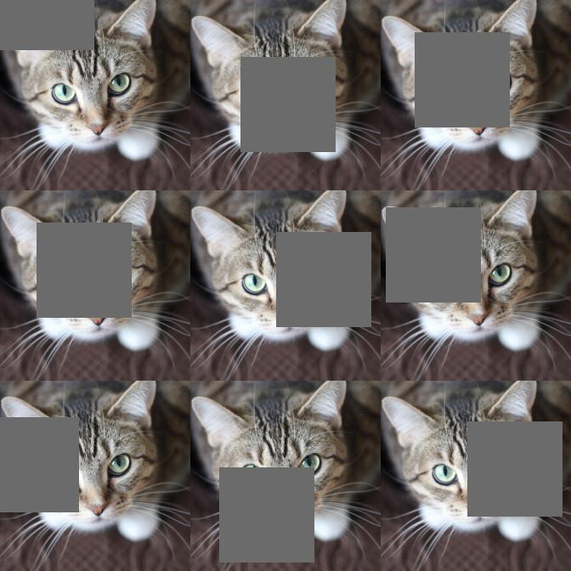

Slide 52
from keras.preprocessing.image import ImageDataGenerator
ImageDataGenerator(
rotation_range=10.,
width_shift_range=0.1,
height_shift_range=0.1,
shear_range=0.,
zoom_range=.1.,
horizontal_flip=True,
vertical_flip=True)
In the above code, the ImageDataGenerator for data augmentation includes
rotation of the image,
shifting the image left/right/top/bottom by some amount, flip the image horizontally or vertically,
shear or zoom the image etc.

Slide 53
Main Layers used to build ConvNets
Convolutional +ReLu Layer
Pooling (Sub-sampling) Layer
Fully-Connected followed by output layer (Classification)

Slide 54
Convolutional Neural Networks are simply neural networks that use convolution in place of general matrix multiplication in at least one of its layers.
The convolutional layer can be thought of as the eyes of the CNN.
The layers of a CNN have neurons arranged in 3 dimensions: width, height and depth.

Slide 55
RELU layer applies an element-wise activation function[ max(0,x)], leaving the size of the volume unchanged ([32x32x12]).
POOL layer will perform a down-sampling[decrease the size) operation along the spatial dimensions (width, height), resulting in volume such as [16x16x12].
FC (i.e. fully-connected) and output layer will compute the class scores, resulting in volume of size [1x1x10], where each of the 10 numbers correspond to a class score, such as among the 10 categories of CIFAR-10

Slide 56
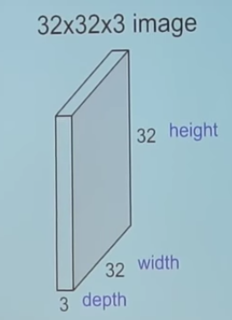
Unlike neural networks, where the input is a vector, in CNNs the input is a multi-channeled image (3 channeled in this case).

Slide 57
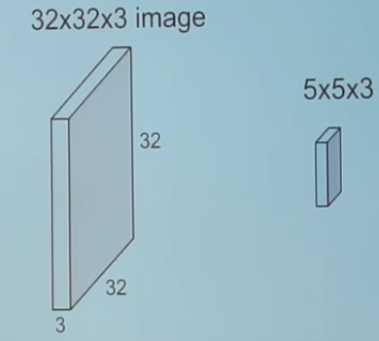
5*5*3 filter slides over the complete image and along the way it takes the dot product between the filter and chunks of the input image.
For every dot product taken, the result is a scalar.

Slide 58
CONVOLUTION OPERATION

Slide 59
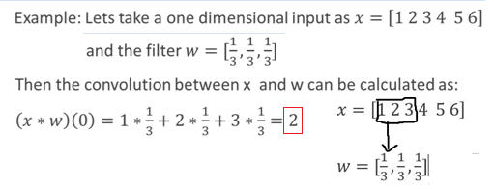
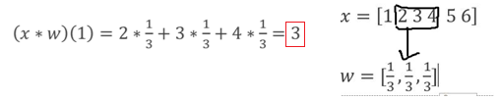

Slide 60
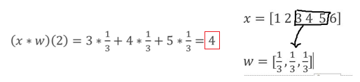
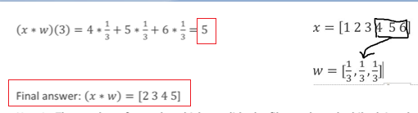

Slide 61
Stride: the number of pixels you skip while traversing the input image horizontally and vertically during convolution after each element-wise multiplication of the input weights with those in the filter.
It is used to decrease the input image size considerably

Slide 62
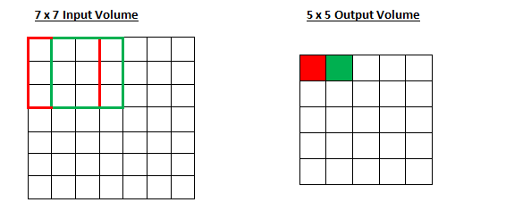
The amount by which the filter shifts is the stride.
Stride S=
ONE

Slide 63
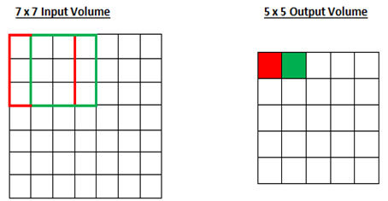
F is Filter size (spatial dimension)
P is Padding
S is Stride
W =H is input height/length
O is the output height/length

Slide 64
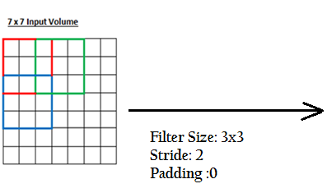
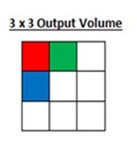
convolved image
stride value is increased if you want receptive fields to overlap less and want smaller spatial dimensions.

Slide 65
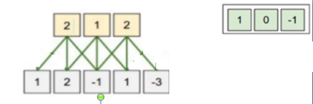
These many neurons would have “fit” across the original input.

Slide 66
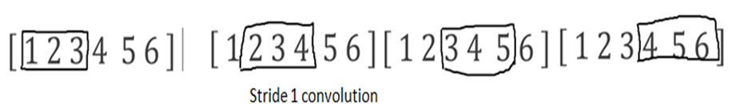
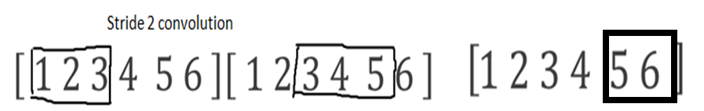
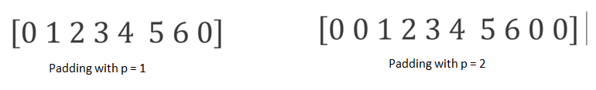
Zero-padding is used so that the resulting image doesn't shrink.

Slide 67
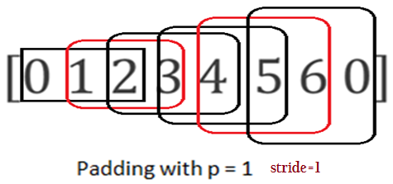
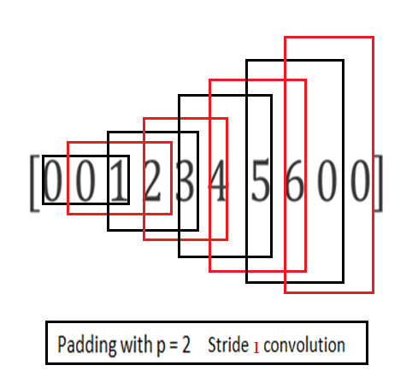

Slide 68
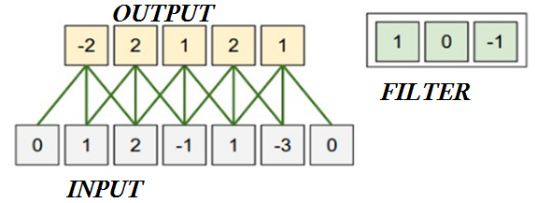
What is size of input?
5, do not add padding
What is size of filter?
3
What is size of output
5
What is size of zero-padding?
1
What is Stride ?
1

Slide 69
Can you use stride S = 2?, Output size ?
Yes, Output: 3
Stride of 3 ?
No
it wouldn't fit neatly across the volume.
Stride is normally set in a way so that the output volume is an integer and not a fraction.

Slide 70
With Stride of 1,Filter size F, output size would be of same size as input, with zero padding of

Slide 71
Input Size : 32 x 32 x 3, with stride(S=1), Filter size (5x5) , For output to be of same size as input, what zero padding(P) is required ?

Slide 72
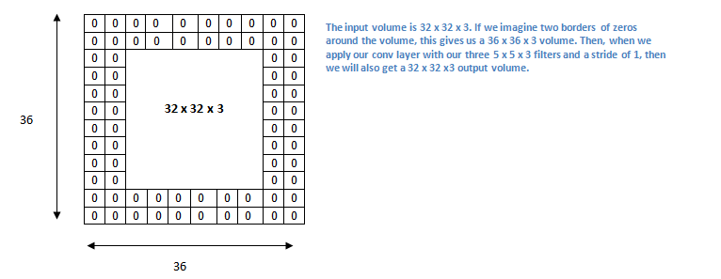
.

Slide 73
Spatial dimensions decrease when we apply convolution. As we keep applying conv layers, the size of the volume will decrease faster.
In early layers of our network, as much information about the original input volume is to be preserved to extract low level features.
to keep our volume same we apply padding

Slide 74



Slide 75


FIND THE CONVOLVED VALUE AND ITS LOCATION IN OUTPUT

Slide 76
Padding is generally used to add columns and rows of zeroes to keep the spatial sizes constant after convolution, doing this might improve performance as it retains the information at the borders.
Parameters for the padding function in Keras are Same- output size is the same as input size by padding evenly left and right, but if the amount of columns to be added is odd, it will add the extra column to the right.

Slide 77


Consider a 5 x 5 image and 3 x 3 Filter as shown below :
In CNN terminology, the 3×3 matrix is called a ‘filter‘ or ‘kernel’ or ‘feature detector’ .
INPUT IMAGE: 5x5
FILTER/KERNEL: 3x3
STRIDE :1
Convolved FEATURE MAP :3x3
slide the Filter (orange) matrix over original image (green) by 1 pixel (also called ‘stride’)

Slide 78


Slide 79


Slide 80


Slide 81


Slide 82


Slide 83


Slide 84


Slide 85


Slide 86


Slide 87


Slide 88


Slide 89


Slide 90


Slide 91


Slide 92

feature map/activation map having only 1 filter of 5x5 size ?
Number 3 in 5x5x3 is implied.
Size of Feature Map ?
28x28x1

Slide 93


Size of Feature Map ?
28x28x2

Slide 94


Slide 95
A filter applied to an input image or input feature map always results in a single number. T/F
The systematic left-to-right and top-to-bottom application of the filter to the input results in a two-dimensional feature map. T/F
One filter creates one corresponding feature map.
A filter must have the same depth or number of channels as the input, yet, regardless of the depth of the input and the filter, the resulting output is a single number and one filter creates a feature map with a single channel.

Slide 96
If the input has one channel such as a grayscale image, then a 3×3 filter will be applied in 3x3x1 blocks.
If the input image has three channels for red, green, and blue, then a 3×3 filter will be applied in 3x3x3 blocks.
If the input is a block of feature maps from another convolutional or pooling layer and has the depth of 64, then the 3×3 filter will be applied in 3x3x64 blocks to create the single values to make up the single output feature map.

Slide 97
Number of Channels:
It is the equal to the number of color channels for the input but
in later stages it is equal to the number of filters we use for the convolution operation.
More the number of filters used, more are the features learnt

Slide 98
The CNNs have several different filters/kernels consisting of trainable parameters which can convolve on a given image spatially to detect features like edges and shapes.
This high number of filters learn to capture spatial features from the image based on the learned weights through back propagation

Slide 99

Filters are nothing more than weights, which get updated.
Filters are chosen only in the sense of specifying how many filters [hyperparameter] at each level of the CNN.
Backprop will determine the weights of the filters

Slide 100
The filter on
the left might activate strongest when it encounters a horizontal line
the one in the middle for a vertical line
in the right for edge

Slide 101


Slide 102


With added layers, the architecture adapts to the High-Level features as well, giving us a network which has the wholesome understanding of images in the dataset

Slide 103

What do we identify this picture with ?

Slide 104
“flying bird with sun and sea in the background”.
We make this identification based on the whole scene .
We do not separately look at the sun, bird, sea and then try to classify the image.
In CNNS first layer might detect edges in the image, second layer might detect curves present in the bird, third layer might detect the whole bird. After detecting these features, they can be combined to make a meaningful classification of the image.
Minimising this gap between high level representations ( interpreted by humans ) and low level features ( detected by algorithms ) is the main objective in object detection problems.

Slide 105
Smaller filters collect local information, bigger filters collect global, high-level information.
In general, we use filters with odd sizes
The ultimate genius of the CNN is the network's ability to automatically discover and learn its own discriminative features.
The downside of CNNS is the large amounts of training samples to give a better & more precise output

Slide 106

What kernel sizes you suggest for these three pictures where The area occupied by the dog is different in each image?
Salient parts in the image can have extremely large variation in size.

Slide 107
Choosing the right kernel size for the convolution operation is important.
Larger kernel is preferred for information that is distributed more globally
Smaller kernel is preferred for information that is distributed more locally.

Slide 108


Show the positioning of kernels on image to get in convolved image -8

Slide 109

[-2-2]+
[ -2+1-2] +
[2-1-1-1] + 0(bias)= -8
Number of parameters/weights ??
54
[FxFxD₁ ]xK
[(3x3)x3]x2=54

Slide 110

No. of Parameters = (F x F x in-depth) x number of filters
= (5x5x3)x10 =750
No. of parameters =
Input-depth x output-depth(=no. of filters) x Filter size
= 3 x 10 x 5 x 5 =750
If bias is there( one bias for each filter)
No. of Parameters = [F x F x in-depth + 1] x number of filters
= [5x5x3 + 1]x10 =760
No. of parameters
=( In-depth x Filter size + 1)x out-depth (no. of filters)
= ( 3 x 5 x 5 + 1) x10 = 760

Slide 111
Hyperparameters controlling the size of the output volume –
-Depth: no of filters, each learning to look for something different in the input.
-Size of filter/kernel
– the stride with which we slide the filter.
– padding the input volume with zeros around the border.

Slide 112




DRAW Output Feature map, S=1, P=0
DRAW Output Feature map, S=1, P=0

Slide 113



Slide 114

TEST PROBLEM
If all volumes of CNN have C channels(filters)
D_{in} =C
D_{out} =C
number of parameters required to be trained for single 7x7 conv layer ?D_{in} x7x7xD_{out}
= C(depth )x7x7xC(no. of filters=channels)
= 49C²

Slide 115
(ii) number of parameters required to be trained for three 3x3 conv layers
1 conv layer= ( C(depth)x3x3xC(no. of filters)) = 9C²
3 conv layers = 3x9C² = 27C²
Stacking CON layers with tiny filters as opposed to having on CON layer with big filters allows us to express more powerful features of the input, with fewer parameters.

Slide 116
Example: Input volume of 32x32x128 convolved with 32 conv filter (1x1) x128 is implied.
Output Volume/feature map ?
Solution: 32x32x32
shrunk the number of channels from 128 to 32.
1x1 convolution alters the depth of the input volume( by choosing filters more or less than the depth of input volume)

Slide 117
What does a 1x1 convolutional layer do?
A 1x1 convolution operation without padding and with Stride of 1 ALTERS the depth dimension of an input volume ( W x H x D) leaving its width and height intact [ [(W-1) /1] +1=W ]
n x n convolution matrix, not only squashes the depth dimension of an input volume , but -alters the width and height of the input volume too, depending on Filter size, padding and stride.

Slide 118
1x1 convolution alters the depth of the input volume( by choosing filters more or less than the depth of input volume ),
Passes the input volume through a non-linearity [Applying ReLU]
(if the number of 1x1 filters is kept same as input volume, then all it does is add a nonlinearity(Relu).

Slide 119

What is Stride and padding ??
STRIDE =1, P = (F -1)/2 = 2
W =[(W- F + 2P)/S + 1]= [(28 -5 + 2x2)/1] + 1]= 28

Slide 120

What is Stride and padding ??
S=1,P=0 =( F-1)/2
What is Stride and padding ??
S=1,P=2 =(F-1)/2

Slide 121

CASE A
CASE B
Input & output sizes in caseA and case B are SAME
Calculate number of parameters to be learnt In both cases

Slide 122
Number of parameters to be learnt : 192x5x5x32 = 1,53,600
Number of parameters :
192x1x1x16+ 16x5x5x32= 15,872
Large reduction in parameters !
Input-Output Size SAME

Slide 123
Which of the two below is computationally less costly ?
(i)input (256 depth) -> 1x1 convolution (64 filters/depth) -> 4x4 convolution (256 filters/depth)
(ii)input(256 depth)->4x4 Convolution(256 filters/depth)
Assume that the computation cost is proportional to the number of weights.
case (i) num_weights=in_depth x out_depth x kernel_size
= 256x1x1x64 + 64x4x4x256= 2,78,528
the num_weights = in_depth x out_depth x kernel_size
= 256x4x4x256 =10,48,576
The bottom one is about ~3.7x slower.

Slide 124
1x1 and 3x3 convolutional Kernels are widely used for their benfit of reducing computations, pruning parameters and improving accuracies
3x3 are the smallest filters that can capture the notion of left/right, up/down, and centre.
Although the receptive fields of 3x3 filters are small, a few continuous 3x3 layers can get the same receptive field of bigger filters.

Slide 125
To summarize, the Conv Layer:
Accepts a volume of size W₁xH₁xD₁
Requires four hyperparameters:
1.Number of filters ( K ) =depth of output image D₂
2. Spatial extent of Filters (FxF)
3. Stride of filter(S )
4. Amount of zero padding (P)
Produces output of volume W₂xH₂xD₂
W₂= [(W₁− F + 2P) /S] +1
H₂ = [(H₁ − F + 2P)/S] +1
D₂ = K (Number of filters)
Number of Parameters : K x(F x F x D₁)=D₁ x D₂ x F x F

Slide 126
Padding = Same: means the input image ought to have zero padding so that the output in convolution doesnt differ in size as input.
we add a n-pixel borders of zero to tell that ‘dont’ reduce the dimension and have same as input.
Padding = Valid: means we dont add the zero pixel padding around the input matrix, and its like saying, we are ready to loose some information.
when we do valid padding, the convolution happens and based on kernel size we taking, only the inside pixel of input is considered to be ‘valid’ which appears in feature map.

Slide 127
Padding Type | Description | Impact
Valid | No padding | Dimensions reduce
Same | Zeros around the edges | Dimensions stay the same

Slide 128


Slide 129


Analogous to HWR

Slide 130
POOLING
Outputs of several nearby feature detectors are combined into a local or global ‘bag of features’, in a way that preserves task-related information while removing irrelevant details.
Pooling is used to achieve
Invariance to image transformations,
More compact representations, and
Better robustness to noise and clutter.

Slide 131
Pooling layer is also called subsampling or downsampling
Pooling is mostly used immediately after the convolutional layer to reduce the spatial size but retains the most important information (depth).
Only width and height are changed not depth.
Pooling can be of different types: Max, Average, Sum etc.

Slide 132

Observe number of channels before and after pooling
After Pooling, Number of channels in output will remain the same ( depth of the output will remain same as input).

Slide 133

In case of Max Pooling, define a window and take the largest element from the feature map within that window.

Slide 134
A filter of size 2x2 with a stride of 2 reduces the spatial size of the input to half. [(4-2)/2 ]+1 =2

Slide 135


Slide 136
for input volume of height h, width w and depth d, on applying max pooling with a filter of size 2x2 and stride of 2, an output volume of size [(h/2)x(w/2)]x d would result.
For each channel apply the max pooling and then stack together all the channels.

Slide 137



Pooling: Max
Input : 5x5
Filter : 3x3
Case A :Stride :1, Padding:0
Output : [(5-3+2x0)/1]+1=3x3
Case B: Stride :2, Padding:0
Output : [(5-3+2x0)/2]+1=2x2

Slide 138


Slide 139

Average Pooling performs the average over all the pixel values for a particular portion of the image

Slide 140
Pooling Operation Introduces how many parameters ??
Zero parameters since it simply computes a fixed function of the input
Hyperparameters : Stride, Filter size, avg/max pooling

Slide 141
Advantages of pooling
makes the input representations (feature dimension) smaller and more manageable
reduces the number of parameters and computations in the network, therefore, controls overfitting
makes the network invariant to small transformations, distortions and translations in the input image (a small distortion in input will not change the output of Pooling – since we take the maximum / average value in a local neighborhood).

Slide 142
Even with tiny kernel of 2x2 and a stride of 2, output will be two times smaller in both width and height, so area is 4 times smaller.
Average pooling retains more information, in comparison to max pooling which simply drops 75% of input values
Max pooling performs better, when background is dark, as in MNIST dataset, the digits are represented in white color(value 255) and the background is black(value 0). So, max pooling is used.
Max pooling preserves only the strongest features,

Slide 143
tf.nn.max_pool of tensorflow supports two types of padding, ‘
‘VALID' and 'SAME'.
With 'VALID' padding tf.nn.max_pool returns output whose value can be computed without using any padding.
'VALID' option may discard the border elements of input.
With 'SAME' padding tf.nn.max_pool returns output whose value can be computed by applying the filter to all input elements. Border elements are computed using zero padding.
The output may be same or smaller than the input depending on the stride option.

Slide 144



Slide 145



Slide 146
Batch normalization - A technique for training very deep neural networks that standardizes the inputs to a layer for each mini-batch.
Training deep neural networks with tens of layers is challenging as they can be sensitive to the initial random weights and configuration of the learning algorithm.
the distribution of the inputs to layers deep in the network may change after each mini-batch when the weights are updated.

Slide 147


Slide 148
Batch Norm before activation or after the activation?
original paper talks about applying batch norm just before the activation function, it has been found that applying batch norm after the activation yields better results.
This seems to make sense, as if we were to put a activation after batch norm, then the batch norm layer cannot fully control the statistics of the input going into the next layer since the output of the batch norm layer has to go through an activation.
An exception is for the sigmoid activation function wherein you need to place the batch normalization layer before the activation to ensure that the values lie in linear region of sigmoid before the function is applied.

Slide 149
Principles/Conventions to build a CNN architecture
Always start by using smaller filters is to collect as much local information as possible, and then gradually increase the filter width to reduce the generated feature space width to represent more global, high-level and representative information
the number of channels should be low in the beginning such that it detects low-level features which are combined to form many complex shapes(by increasing the number of channels) which help distinguish between classes.

Slide 150
The number of filters is increased to increase the depth of the feature space thus helping in learning more levels of global abstract structures.
By convention the number of channels generally increase or stay the same while we progress through layers in our convolutional neural net architecture
General filter sizes used are 3x3, 5x5 and 7x7 for the convolutional layer for a moderate or small-sized images
for Max-Pooling use 2x2 or 3x3 filter sizes with a stride of 2. Larger filter sizes and strides may be used to shrink a large image to a moderate size

Slide 151


Slide 152
FLATTEN THE FEATURE MAP
To finally classify the image into a category, say cat or dog, set up a Multi-Layer Perceptron on top of the last convolution layer.
Feeding a MLP requires input vectors (one-dimension arrays), So “flatten” the output feature map.

Slide 153
Fully Connected layer
Every neuron in the previous layer is connected to every neuron on the next layer like normal FFNN.
Output from the convolution and pooling layers represent high-level features of the input image.
Purpose of the Fully Connected layer is to use features extracted from Conv+Pooling layers for classifying the input image into various classes using SOFTMAX function

Slide 154
pass 128 nxn filters[S=1,P=0] over an image of dimensions nxn. Output/result?
a vector of length 128.
pass 16 filters of 5x5[S=1,P=0], over 5x5x16(output of conv layer), output map will have vector length of??
16
If you pass 400 filters of 5x5, over 5x5x16,
output map will have vector length of
400

Slide 155


Slide 156


DROPOUT: Unlike L1 and L2 regularization,
dropout doesn't modify the cost function.
Instead, it modifies the network itself.

Slide 157
A related heuristic explanation for dropout is given in one of the earliest papers to use the technique**ImageNet Classification with Deep Convolutional Neural Networks, by Alex Krizhevsky, Ilya Sutskever, and Geoffrey Hinton (2012)
"This technique reduces complex co-adaptations of neurons, since a neuron cannot rely on the presence of particular other neurons. It is, therefore, forced to learn more robust features that are useful in conjunction with many different random subsets of the other neurons.“

Slide 158
A related heuristic explanation for dropout is given in one of the earliest papers to use the technique**ImageNet Classification with Deep Convolutional Neural Networks, by Alex Krizhevsky, Ilya Sutskever, and Geoffrey Hinton (2012)
we can think of dropout as a way of making sure that the model is robust to the loss of any individual piece of evidence.
In this, it's somewhat similar to L1 and L2 regularization, which tend to reduce weights, and thus make the network more robust to losing any individual connection in the network.

Slide 159


Slide 160
Abstract
Deep neural nets with a large number of parameters are very powerful machine learning systems. However, overfitting is a serious problem in such networks. Large networks are also slow to use, making it difficult to deal with overfitting by combining the predictions of many different large neural nets at test time. Dropout is a technique for addressing this problem. The key idea is to randomly drop units (along with their connections) from the neural network during training. This prevents units from co-adapting too much. During training, dropout samples from an exponential number of different “thinned” networks. At test time, it is easy to approximate the effect of averaging the predictions of all these thinned networks by simply using a single unthinned network that has smaller weights. This significantly reduces overfitting and gives major improvements over other regularization methods. We show that dropout improves the performance of neural networks on supervised learning tasks in vision, speech recognition, document classification and computational biology, obtaining state-of-the-art results on many benchmark data sets. Keywords: neural networks, regularization, model combination, deep learning

Slide 161



Slide 162


Slide 163


Slide 164
What could go wrong?
If you turn off too many neurons, then remaining neurons simply will not be able to cope with their work and the result will only get worse.
It can also be thought of as an ensemble technique in machine learning.
Remember, that the ensemble of strong-learners performs better than a single model as they capture more randomness and less prone to overfitting.
But ensemble of weak-learners more prone to retraining than the original model.
As a result, dropout takes place only with huge neural networks.

Slide 165
if neurons are randomly dropped out of the network during training, other neurons will have to step in and handle the representation required to make predictions for the missing neurons.
This results in multiple independent internal representations being learnt by the network.
The effect is that the network becomes less sensitive to the specific weights of neurons.
This in turn results in a network that is capable of better generalization and is less likely to overfit the training data.

Slide 166


Slide 167

Hinton et al. (2012): Dropout can be seen as an efficient way to perform model averaging across a large number of different neural networks, where overfitting can be avoided

Slide 168
Transfer Learning
Why train
when you can finetune ?

Slide 169
In transfer learning, we take the pre-trained weights of an already trained model(one that has been trained on millions of images belonging to 1000’s of classes, on several high power GPU’s for several days) and use these already learned features to predict new classes.

Slide 170
THE ADVANTAGES OF TRANSFER LEARNING :
1: There is no need of an extremely large training dataset.
2: Not much computational power is required.As we are using pre-trained weights and only have to learn the weights of the last few layers.

Slide 171
One of the powerful tasks of deep learning is that, sometimes we can take the knowledge the neural network has learnt from one task (task A) and apply that knowledge in another task (task B). This is called transfer learning. — Andrew Ng
It is achieved by freezing the weights until the initial or mid-layers are learned on the data for task A, and
Removing the last layer or a few of the last layers, and adding new layers and training those parameters using the data for task B.

Slide 172
Several companies like Google and Microsoft have released state-of-the-art neural network architectures that are optimized for image recognition.
These companies have Huge Resources And Expertise at their disposal ,so
it is likely that you can trust that these models would have superior performance to any in-house model you can cook up.

Slide 173
How TRANSFER LEARNING work?
First build the architecture of the original model using Keras and then load the model weights of the trained network (you need to download these first; they usually come in .h5 format-Hierarchical Data Format (HDF)).
Freeze the weights of the initial layers by setting the layers to have the trainable=False parameter. [need not train]
WHY this works ???

Slide 174
Because the initial layers of a convolutional neural network (used for processing images) contain primitive information about the image, such as interpretations of lines, edges, shapes, and other low-level features.
As we go deeper into the network, the objects become more complex and high-level, which is where the network begins to differentiate more clearly between image qualities.

Slide 175
The idea here is that we are not trying to teach the network to examine images, as it has already been trained well to do this by Google or Microsoft. We just need to fine-tune it for our use-case.
So, we can set the fully connected network layers (or a subset of them) at the output to be trainable, and perhaps the final convolutional layer (if we have enough data) to be trainable, and then train the network on our data.
This procedure has the added benefits of requiring fewer data to train the model

Slide 176
Unless you’re doing cutting edge research and trying to break the fundamental state-of-the-art, transfer learning should be the default method of practice.
Training networks from scratch on new data is challenging, time consuming

Slide 177

This procedure has the added benefits of requiring fewer data to train the model

Slide 178


Slide 179

Proceedings of the thirteenth international conference on artificial intelligence and statistics. 2010.

Slide 180
Why shouldn’t you initialize the weights with zeroes or randomly (without knowing the distribution):
If the weights in a network start too small, then the signal shrinks as it passes through each layer until it’s too tiny to be useful.
If the weights in a network start too large, then the signal grows as it passes through each layer until it’s too massive to be useful.

Slide 181
To prevent the gradients of the network’s activations from vanishing or exploding, we will stick to the following rules of thumb:
The mean of the activations should be zero.
2. The variance of the activations should stay the same across every layer

Slide 182
Initialization techniques makes sure the weights are ‘just right’, keeping the signal in a reasonable range of values through many layers.
two popular initialization schemes:
Xavier / Glorot
He [kaiming He et al]

Slide 183


Xavier Glorot and Bengio
The initialization strategy for ReLU activation function and its variants is sometimes called He initialization.

Slide 184
Some standard CNNs

Slide 185

AlexNet (2012)
5 convolutional layers followed by 3 FC layers
1000 Category • 1.2M Training Images • 150K Test Images
[Alex Krizhevsky, NIPS (Neural Information processing System )2012] AlexNet

Slide 186

The input to AlexNet is an RGB image of size 256×256.
All images in the training set and all test images need to be of size 256×256.

Slide 187
Random crops of size 227×227 were generated from inside the 256×256 images to feed the first layer of AlexNet.
Note that the paper mentions the network inputs to be 224×224, but that is a mistake and the numbers make sense with 227×227 instead.

Slide 188
Since AlexNet, [ 5 CNN + 3 FC ] the state-of-the-art CNN architecture is going deeper and deeper.
VGG network , GoogleNet (also codenamed Inception_v1) had 18 and 22 layers respectively.

Slide 189

VGGNet (2014) architecture from
VGG(Visual Geometry Group) Oxford

Slide 190

VGG

Slide 191
VGGNet (2014) architecture from
VGG(Visual geometry Group) Oxford
VGG Net strictly used 3x3 filters with stride and pad of 1, along with 2x2 maxpooling layers with stride 2- uniform architecture

Slide 192
Deep Residual Networks took the deep learning world by storm when Microsoft Research released Deep Residual Learning for Image Recognition.
DRNs led to 1st-place winning entries in all five main tracks of the ImageNet and COCO 2015 competitions, which covered image classification, object detection, and semantic segmentation.

Slide 193


Slide 194
What is Semantic Segmentation?
- It is the task of assigning a unique label (or category) to every single pixel in the image
Applications for semantic segmentation:
Autonomous driving
Robotic vision and understanding - Medical imaging analysis

Slide 195


Slide 196


Slide 197
Semantic Segmentation is process of assigning a label to every pixel in the image -- in stark contrast to classification, where a single label is assigned to the entire picture. Semantic segmentation treats multiple objects of the same class as a single entity.
Instance segmentation treats multiple objects of the same class as distinct individual objects (or instances). Typically, instance segmentation is harder than semantic segmentation.
Instance segmentation can be very useful in applications that are used to count the number of objects, such as counting the amount of foot traffic in a mall.

Slide 198


Slide 199
Deep networks are hard to train because of the notorious vanishing gradient problem — as the gradient is back-propagated to earlier layers, repeated multiplication may make the gradient infinitively small.
As a result, as the network goes deeper, its performance gets saturated or even starts degrading rapidly.
ResNets do not suffer from this problem, have made it possible to train networks with more than 100 layers, even reaching 1000 layers.

Slide 200

ResNET: A novel architecture with “skip/shortcut connections”

Slide 201
In traditional neural networks, each layer feeds into the next layer.
In a network with residual blocks, each layer feeds into the next layer and directly into the layers about 2–3 hops away.
Essentially, residual blocks allows the flow of memory (or information) from initial layers to last layers.

Slide 202


Slide 203

Element-wise addition is used, Depth is not changed.
In Resnet, a layer only receives outputs from the previous second or third layer, and the outputs are added together Element-wise on the same depth, therefore
it won’t change the depth by adding shortcuts.

Slide 204

Each ResNet block is either 2 layer deep (Used in small networks like ResNet 18, 34) or 3 layer deep( ResNet 50, 101, 152).

Slide 205
A building block of a ResNet is called a residual block or identity block.
A residual block is simply when the activation of a layer is fast-forwarded to a deeper layer in the neural network.
ResNet50 is a 50 layer deep Residual Network. There are other variants like ResNet101 and ResNet152 also.

Slide 206

Depth , if needed can be changed using 1x1 convolution

Slide 207

Intuition behind Residual blocks:
In simple language it is very easy to come up with a solution like F(x) =0 rather than F(x)=x using stack of non-linear cnn layers as function (Think about it).
this function F(x) is what the authors called Residual function.

Slide 208


Slide 209

In DenseNet, each layer obtains additional inputs from all preceding layers and passes on its own feature-maps to all subsequent layers.
Concatenation is used. Feature maps received from other layers are fused through concatenation, and not through summation (like in ResNets).

Slide 210



Slide 211

GoogLeNet (2015) introduced Inception Module
How to decide …
Do you want a 3×3 /1x1/ 5×5/11x11 ?

Slide 212
Why not have filters with multiple sizes operate on the same level?
Do each convolution in parallel and concatenate the resulting feature maps before going to the next layer.

Slide 213

The network essentially would get a bit “wider” rather than “deeper”.

Slide 214


Slide 215
WRITE DIMENSIONS OF A,B,C,D,E,F,G
A=28x28x96
B=28x28x16
C=28x28x192[depth unchanged]ed]
D=28x28x64
E=28x28x128
F=28x28x32
G=28x28x32

Slide 216


Slide 217

resulting outputs are concatenated and sent to the next layer.

Slide 218


Slide 219

ENCODER-DECODER
Used in image segmentation

Slide 220
Image ---> convolution ---> Result
Result ---> transposed convolution ---> "originalish Image“
It is also wrongly called a "deconvolution"

Slide 221
Transposed Convolutions
A transposed convolutional layer carries out a regular convolution but reverts its spatial transformation.
Some sources use the name deconvolution, which is inappropriate because it’s not a deconvolution. – which is mathematical inverse of what a convolutional layer does.
To make things worse deconvolutions do exists, but they’re not common in the field of deep learning.

Slide 222
An actual deconvolution reverts the process of a convolution.
Imagine inputting an image into a single convolutional layer.
Now take the output, throw it into a black box to bring your original image again.
This black box does a deconvolution.

Slide 223

Transposed Convolutions
An image of 5x5 is fed into a convolutional layer.
The stride is set to 2, the padding is deactivated and the kernel is 3x3.
This results in a 2x2 image.
If we wanted to reverse this process, we’d need the inverse mathematical operation
- deconvolution.

Slide 224
Transposed Convolutions
A transposed convolution guarantees that the output will be a 5x5 image as well (reconstruct spatial resolution), while still performing a normal convolution operation.
To achieve this, we need to perform some fancy padding on the input.

Slide 225


Slide 226
A transposed convolution is somewhat similar because it produces the same spatial resolution a hypothetical deconvolutional layer would.
However, the actual mathematical operation that’s being performed on the values is different. A transposed convolutional layer carries out a regular convolution but reverts its spatial transformation.

Slide 227

Describe the operation
2D convolution on 5x5 input, using a kernel size of 3, stride of 1 and padding of 1

Slide 228

Dilated convolutions introduce another parameter to convolutional layers called the dilation rate.
dilation rate k=1
is normal convolution
k=2 means
skipping one pixel per input,
k=3 means
skipping two pixels per input
k=4 means
skipping 3 pixels.
Dilated Convolutions

Slide 229

WRITE k VALUES
k=1 k=2 k=4
Receptive Field grows from 3x3 to 7x7 to 15x15
Filter size same :3x3, number of parameters to be trained remain the same (=9)

Slide 230
dilated convolution works in a similar way to a normal convolution, the major difference being that the receptive field no longer consists of contiguous pixels, but of individual pixels separated by other pixels.
Dilated Convolution delivers a wider field of view at the same computational cost.
helpful in Encoder-Decoder architectures - combining the upscaling of an image with a convolution, instead of doing two separate processes.

Slide 231
END

